Slide 1
NIOS II Processor

Slide 2
Reminders
Quiz due on Sunday
Assembly, NIOSII, and Embedded SW lectures
No demo this week on Friday – Class Cancelled
Lab 1 due
Lab 2 prelab due

Slide 3
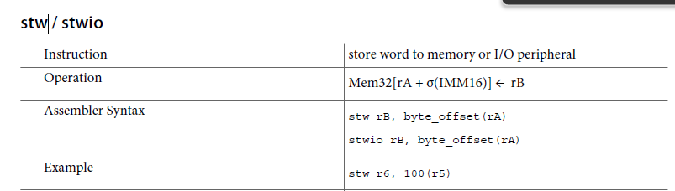
Last Weeks Questions
What is a caller saved register?
Volatile registers used to hold temporary values that need do not need to be preserved between calls
Call refers to a procedural access
Callee saved registers are non-volatile and must be saved if a function needs to overwrite the value
Can a stw offset be a register? No

Slide 4
Processor Types - CISC
CISC Processor Architecture
CISC ➔ Complex Instruction Set Computer
Processors that are easy to program and make efficient use of memory.
Earliest machines were programmed in assembly language and memory was slow and expensive
Big programs require a lot of memory $$$$
CISC developed to make compiler development simpler
Shifts burden of generating machine instructions to the processor
Ex: Instead of compiler writing long machine instructions to calculate a square-root →ability was built-in CISC processor
Instructions require multiple clock cycles to execute
Examples:
Intel 80x86
Motorola 68K series

Slide 5
CISC Processors
CISC Instruction Sets
More complex instructions
Instruction fit into multiple words
More complex hardware
Shorter programs
Complex address modes supported
Memory-to-memory transfer supported

Slide 6
Processor Types - RISC
RISC Processor Architecture
RISC➔ Reduced Instruction Set Computer
Processor architecture that uses small, highly-optimized set of instructions
RISC Characteristics
one cycle execution time
RISC processors have a CPI (clock per instruction executed)
Pipelining
Technique for simultaneous execution of instructions
Large number of registers
Prevent large interactions with memory
Examples:
ARM
Nios II
PowerPC

Slide 7
RISC Processors
RISC Instruction Sets
Simpler instructions
Instruction fits into single word
Simpler hardware
Faster instruction execution
Longer programs
Simpler address modes
Load/Store architecture used
Memory only access via load/store instructions
Arithmetic/logic operations work on register

Slide 8
Processor Types
CISC | RISC
Emphasis on hardware Software simple | Emphasis on software Hardware simple
Includes multi-clock, complex instructions | Single-clock, reduced instruction only
Memory-to-memory: "LOAD" and "STORE" incorporated in instructions | Register to register: "LOAD" and "STORE" are independent instructions
Small code sizes, high cycles per second | Low cycles per second, large code sizes
Transistors used for storing complex instructions | Spends more transistors on memory registers
RISC systems shorten execution time by reducing the clock cycles per instruction (i.e. simple instructions take less time to interpret)
CISC systems shorten execution time by reducing the number of instructions per program

Slide 9
Processor Types
CISC and RISC Processor Architecture
Line between RISC and CISC blurring
CISC processor borrowing goodness from RISC
Ex: Pipeline introduced into CISC
RISC processor borrowing goodness from CISC
Ex: More complex addressing added into RISC

Slide 10
Nios II Processor Overview
What is the Nios II Processor?
Soft-core processor developed by Altera (now Intel)
Soft core design ➔ not fixed in silicon
Soft core allows customizing of processor and peripherals
Add processor features as required
Remove unused processor features
Create custom instructions
Nios II is second generation of software processor
32-bit RISC Processor
RISC ➔Simple instructions provide higher performance
If instructions are simple enough to execute very quickly

Slide 11
NIOS II Basics
General-purpose RISC processor core
32-bit instruction set, data path and address space
32 general-purpose registers
Optional shadow register sets – useful for context switching and multitasking systems (RTOS)
32 interrupt sources
External interrupt controller interface for more interrupt sources
Single instruction 32 x 32 multiply and divide producing a 32 bit result
Dedicated instructions for computing 64-bit and 128-bit products of multiplication
Floating-point instructions for single-precision floating-point operations

Slide 12
NIOS II Basics (con’t)
Single-instruction barrel shifter
Access to a variety of on-chip peripherals, and interfaces to off-chip memories and peripherals
Optional memory management unit (MMU) to support operating systems that require MMU
Optional memory protection unit (MPU)
Instruction set architecture (ISA) compatible across all NIOS II processor systems

Slide 13
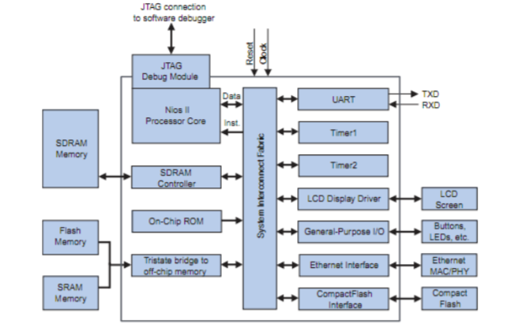
NIOS II Processor System
A NIOS II processor system is equivalent to a microcontroller that includes a processor, memory and a combination of peripherals
Processor
Example system
Peripherals
Off-chip
memory
Input/
Output
On-chip
memory

Slide 14
NIOS II Architecture
The NIOS II architecture defines the following functional units:
Register file
Arithmetic logic unit (ALU)
Interface to custom instruction logic
Exception controller
Internal or external interrupt controller
Instruction bus
Data bus
Memory management unit (MMU)
Memory protection unit (MPU)
Instruction and data cache memories
Tightly-coupled memory interfaces for instruction and data
JTAG debug module

Slide 15
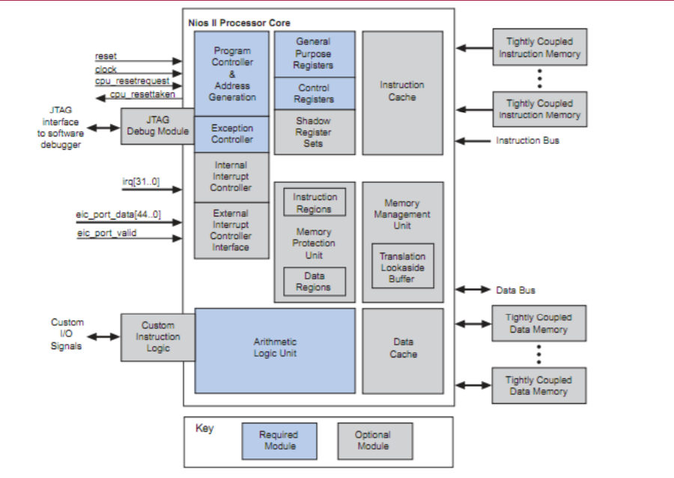
NIOS II Architecture

Slide 16
NIOS II Architecture
The functional units of the NIOS II architecture form the foundation for the NIOS II instruction set
This does not indicate that any unit is implemented in hardware
The NIOS II architecture describes an instruction set, not a particular hardware implementation
A functional unit can be implemented in hardware, emulated in software or omitted entirely
A NIOS II implementation is a set of design choices embodied by a particular NIOS II processor core
Each implementation achieves specific objectives such as smaller core size or higher performance
Allows the NIOS II architecture to adapt to the needs of different target applications.

Slide 17
NIOS II Processor Tradeoffs
Implementation variables generally fit one of three trade-off patterns:
More or less features
Example: To fine-tune performance, you can increase or decrease the amount of instruction cache memory. A larger cache increases execution speed of large programs, while a smaller cache conserves on-chip memory resources
Inclusion or exclusion of a feature
Example: To reduce cost, you can choose to omit the JTAG debug module. This decision conserves on-chip logic and memory resources, but it eliminates the ability to use a software debugger to debug applications.
Hardware implementation or software emulation of a feature
Example: For applications that rarely perform complex arithmetic, you can choose for the division instruction to be emulated in software. Removing the divide hardware conserves on-chip resources but increases the execution time of division operations

Slide 18
Memory and I/O Organization
The flexible nature of the NIOS II memory and I/O organization are the most notable difference between NIOS II processor systems and traditional microcontrollers
Because NIOS II processor systems are configurable, the memories and peripherals vary from system to system
As a result, the memory and I/O organizations varies from system to system

Slide 19
Memory and I/O Organization
A NIOS II core uses one or more of the following to provide memory and I/O access:
Instruction master port – An Avalon Memory-Mapped (Avalon-MM) master port that connects to instruction memory via system interconnect fabric
Instruction cache – Fast cache memory internal to the NIOS II core
Data master port – An Avalon-MM master port that connects to data memory and peripherals via system interconnect fabric
Data cache – Fast cache memory internal to the NIOS II core
Tightly coupled instruction or data memory port – interface to fast on-chip memory outside the NIOS II core
The NIOS II architecture hides the hardware details from the programmer so programmers can usually develop applications without specific knowledge of the hardware implementation

Slide 20
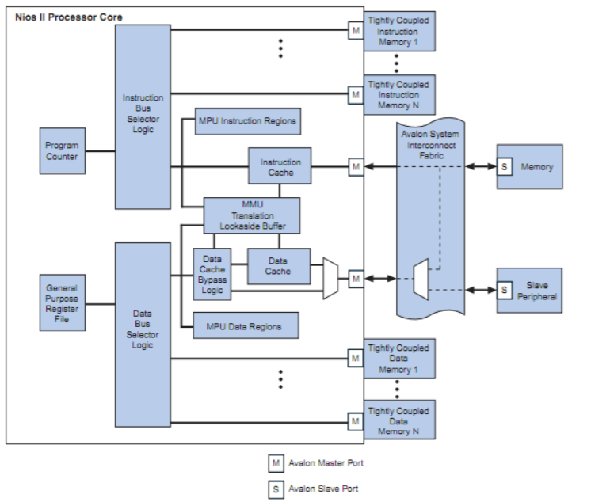
Memory and I/O Organization

Slide 21
Memory and I/O Organization
The NIOS II architecture does not specify anything about the existence of memory and peripherals; the quantity, type, and connection of memory and peripherals are system-dependent
Typically, NIOS II processor systems contain a mix of fast on-chip memory and slower off-chip memory
Peripherals typically reside on-chip, although interfaces to off-chip peripherals also exist

Slide 22
Two Types of Processor Architectures
Harvard
Has physically separate signals and storage for code and data memory
Two data buses and two address buses
Instructions can be fetched simultaneously with data being fetched
VonNeumann
Shared signals and memory for code and data
One data bus and one address bus
Program can be modified by itself

Slide 23
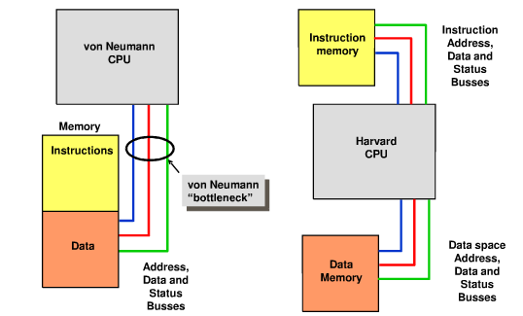
Two Types of Processor Architectures

Slide 24
Instruction and Data Buses
The NIOS II architecture supports separate instruction and data buses, classifying it as a Harvard Architecture
Both the instruction and data buses are implemented as Avalon-MM master ports that adhere to the Avalon-MM interface specification
The data master port connects to both memory and peripheral components, while the instruction master port connects only to memory components
Known as memory-mapped I/O – both the memory and peripherals are mapped into the address space of the data master port
Use pointers to addresses in programs to access both memory and I/O

Slide 25
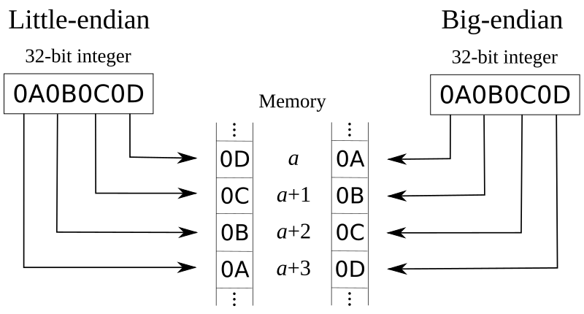
Two Types of Data Storage
Endian describes the order in which bytes of data are stored in memory

Slide 26
Data Storage
The NIOS II architecture is little endian
Words and halfwords are stored in memory with the more-significant bytes at higher addresses
Words in NIOS II are 32 bits
In ESD 1, when in doubt, the answer is 32!
31 |  |  | 0
N + 3 | N + 2 | N + 1 | N

Slide 27
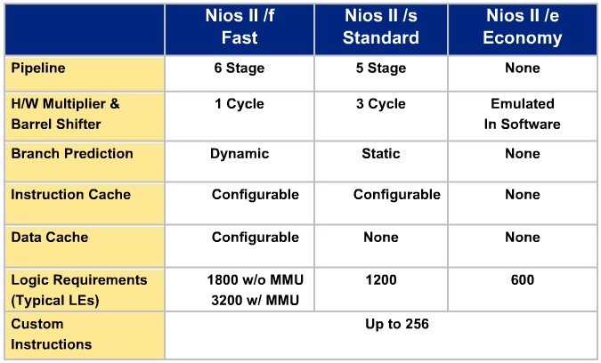
Nios II Processor Overview (Classic)
Three levels of Performance
Allows design scale as requirements change

Slide 28
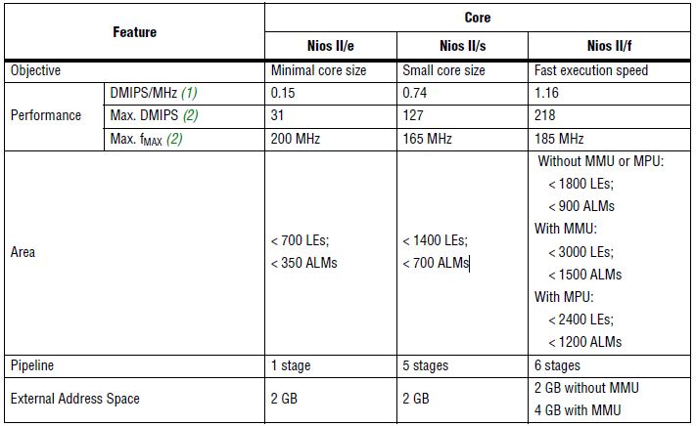
Nios II Processor Overview (Classic)
Three level of Performance
Performance & Size
Performance varies by factor of 9
Size varies by factor of 3

Slide 29
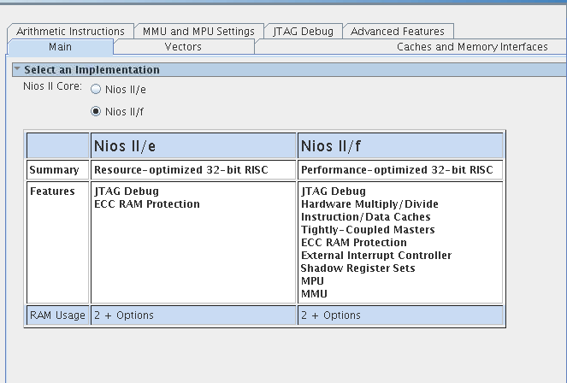
NIOS II Processor Overview
Our version of Platform Designer suggests not using classic
We will choose between NIOS II/e and NIOS II/f
We will be using NIOSII/e this semester, but the default is NIOSII/f
Be sure to choose the correct processor!

